Slide 1
Cryptocurrency Price and Market Analysis
Prepared and presented by Joan Chelangat

Slide 2

Definition of Terms
Cryptocurrency-is any form of currency that exists digitally or virtually and uses cryptography to secure transactions. Cryptocurrencies don't have a central issuing or regulating authority, instead using a decentralized system to record transactions and issue new units
Price- the value of a cryptocurrency unit at a specific point in time.
Market- the environment where a cryptocurrency is traded.
Trading volume-Number of coins traded in a given period of time.
Market capitalization- the total value of all coins in circulation.
Volatility-a measure of the rate at which the price of an asset fluctuates.

Slide 3

Business Problem
Risk Assessment: The dataset is used to assess the risk associated with investing in different cryptocurrencies.

Slide 4
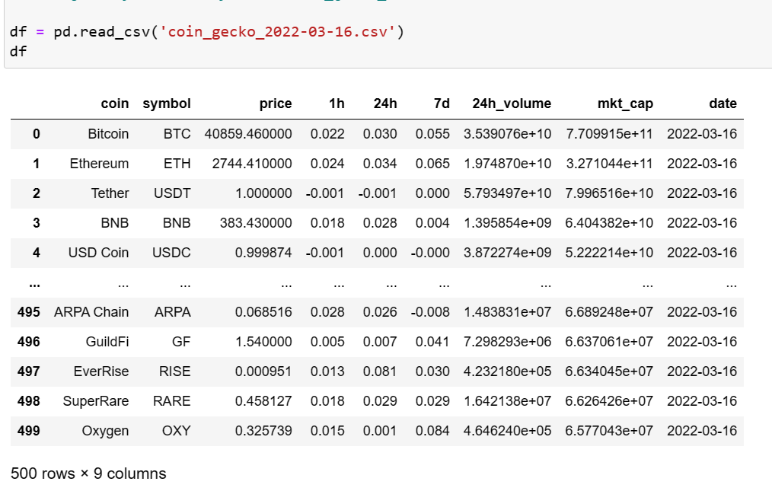
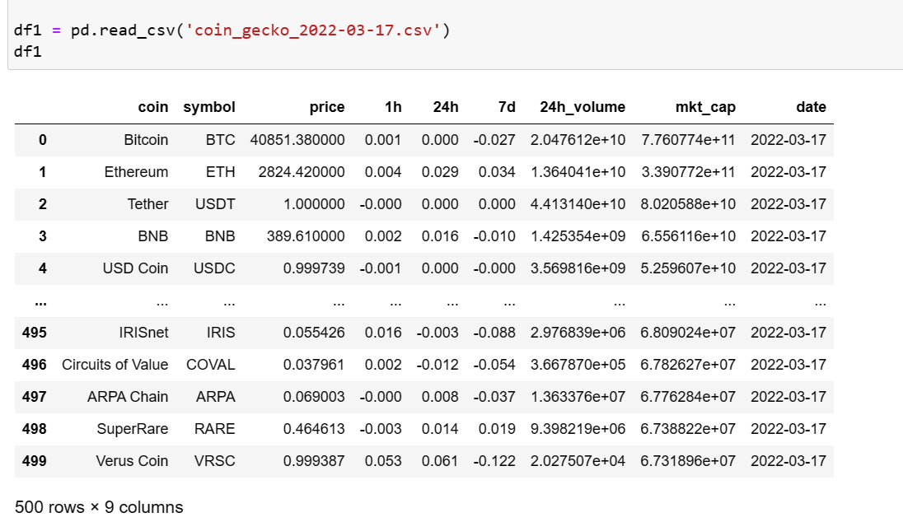
Datasets 1 & 2

Slide 5
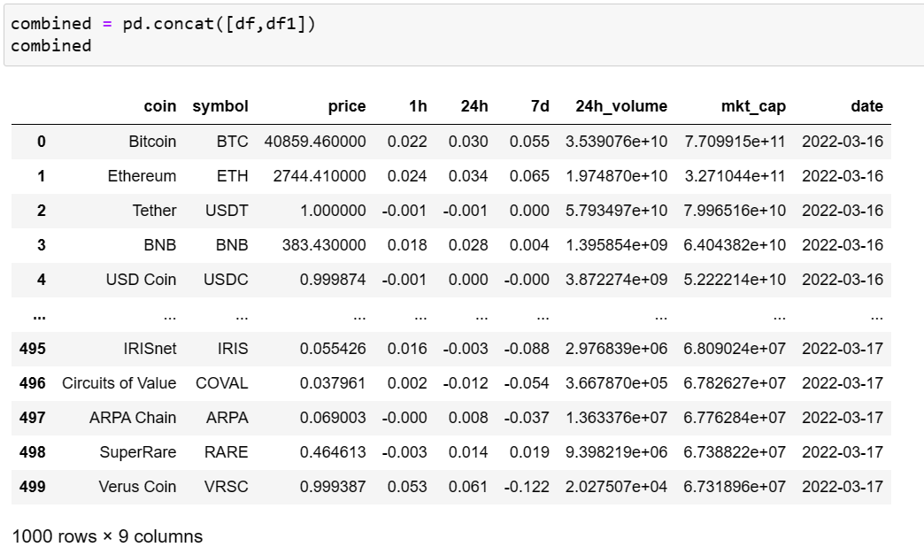
Combined Dataset

Slide 6
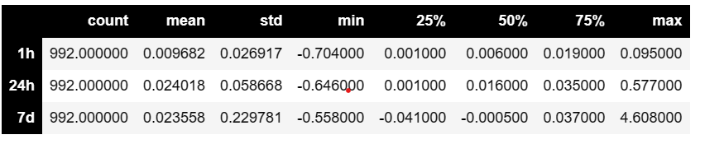
Descriptive Statistics for the combined data
1h: The percentage change in price over the last 1 hour varies between -0.704% and 0.095%. The mean is 0.009682%, indicating a very small average daily return.
24h: The percentage change in price over the last 24 hours varies between -0.646% and 0.577%. The mean is 0.024018%, suggesting a slightly larger average daily return compared to the 1 hour period.
7d: The percentage change in price over the last 7 days varies between -0.558% and 4.608%. The mean is 0.023558%, is also slightly larger than the 1 hour period.
These statistics suggest that while the average daily return is relatively small, there is substantial variation in the short-term price movements. Additionally, the longer the time period, the larger the potential for significant price changes

Slide 7
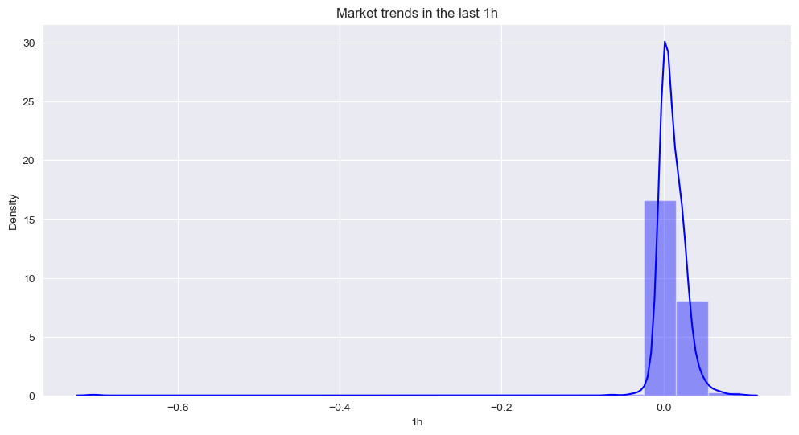
Market Trends

Slide 8
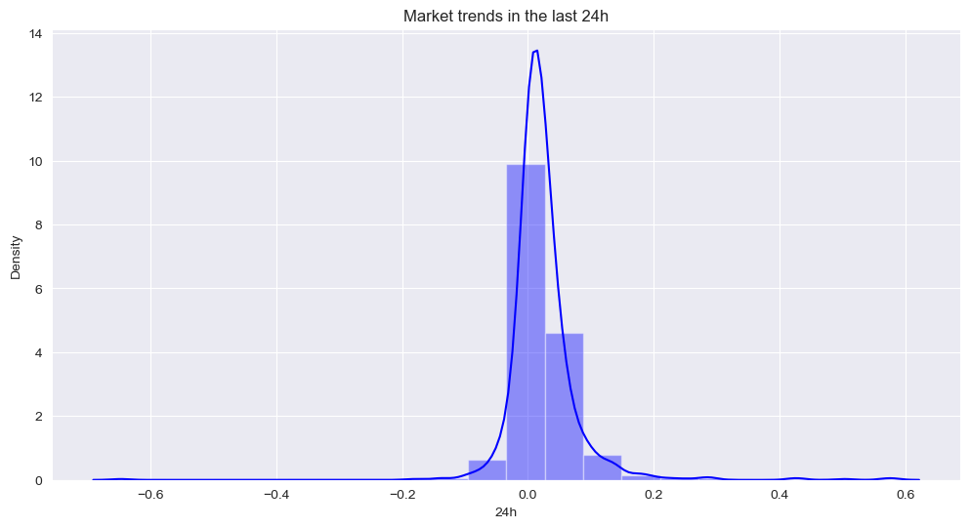
Market Trends

Slide 9
Market Trends

Slide 10
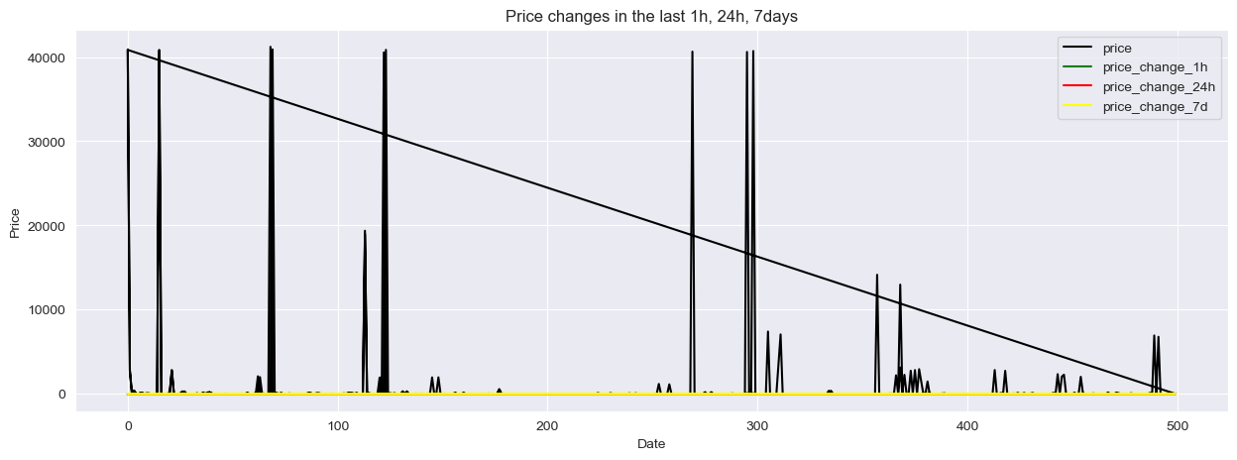
Price changes
The graph shows the relationship of price vs the percentage changes. For example, if the price change over the last 1 hour is positive, it suggests that the price has increased. Similarly, if the price change over the last 24 hours is negative, it suggests that the price has decreased

Slide 11
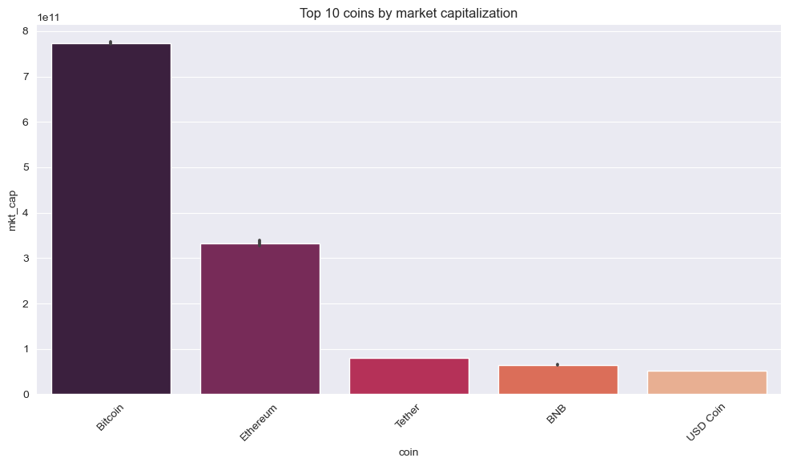
Top 10 Coins

Slide 12
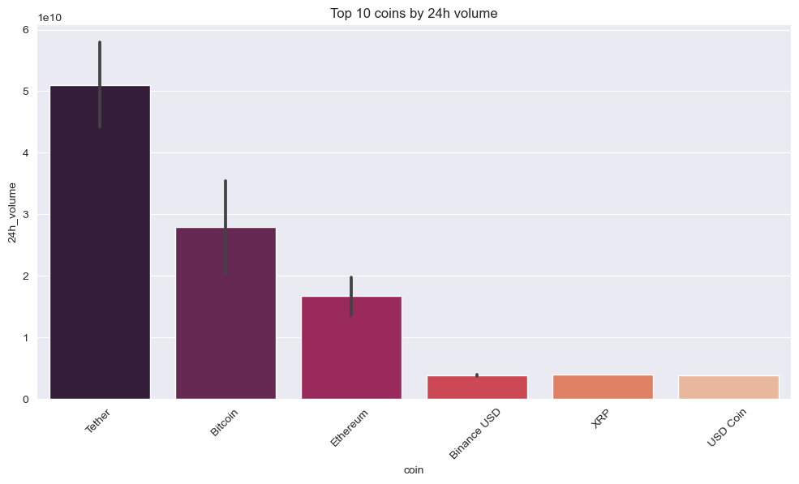
Top 10 coins

Slide 13
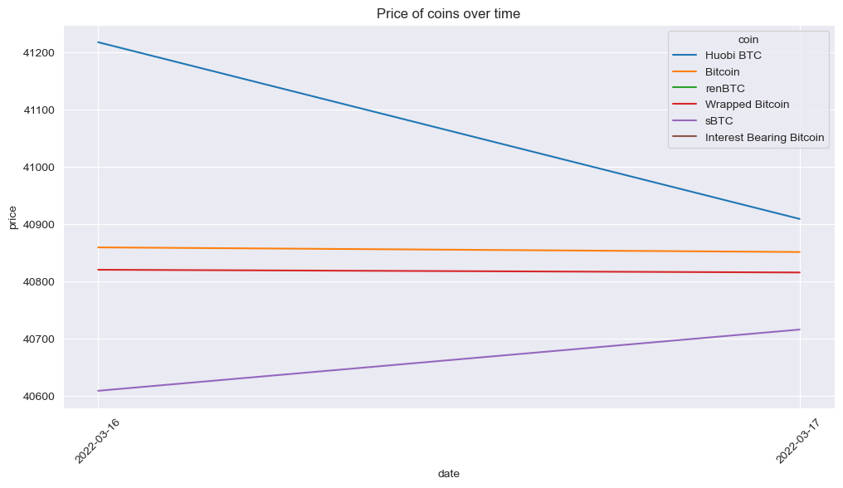
Price Trends

Slide 14
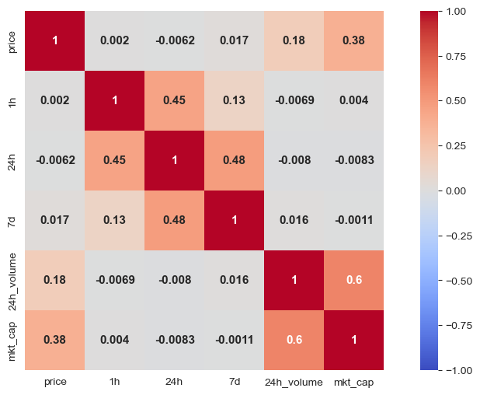
Darker colors represent stronger correlations, while lighter colors represent weaker correlations.

Slide 15
Conclusion
Price Fluctuations: The data clearly shows that the price of cryptocurrencies is highly volatile, with significant changes occurring within short periods (1 hour, 24 hours, 7 days).
Volume Impact: The trading volume, specifically the 24h volume has a direct impact on price changes. Higher trading volumes often correspond with more significant price swings, suggesting that large-scale buying or selling activities can drive up or down the price of a cryptocurrency.
Market Capitalization Correlation: There appears to be a correlation between market capitalization and price volatility. Cryptocurrencies with larger market caps generally exhibit higher volatility. This could be due to the increased influence these currencies have on market sentiment, and thus, their prices can be more sensitive to changes in market conditions.
Historical Trends: The historical data provides insights into the past performance of various cryptocurrencies. By examining price changes over different periods, we can identify trends and patterns that may inform future predictions.

Slide 16
Recommendations
Investors should:
Understand Volatility: Given the high level of volatility in the cryptocurrency market, it's crucial to thoroughly understand what volatility means and how it impacts your investment strategy. Different cryptocurrencies may have different levels of volatility, and this can significantly affect your potential returns.
Monitor Trading Volume: The trading volume can provide valuable insights into the health of the market and the potential for price movement. Large increases in trading volume can signal a strong interest in a particular cryptocurrency, which could potentially lead to price increases.
Consider Market Capitalization: Cryptocurrencies with larger market caps tend to have higher volatility. Therefore, investors should be aware of the market cap of a cryptocurrency before investing.
Diversify Your Portfolio: Given the high level of volatility in the cryptocurrency market, it's recommended to diversify portfolio. This can help mitigate the risk associated with the volatility of individual cryptocurrencies.
Regular Monitoring and Adjustments: Regularly monitor your investments and be ready to make adjustments based on market changes. The cryptocurrency market is dynamic and can change rapidly.

Slide 17
Future Works
Predictive Models: Develop more advanced predictive models to forecast future cryptocurrency prices. This could involve using machine learning algorithms to take into account more factors beyond just past prices.
Feature Engineering: Experiment with creating new features derived from existing data.
Time Series Analysis: Apply time series analysis techniques to better understand the temporal dynamics of cryptocurrency prices. This could involve analysing seasonality, autocorrelation, and other aspects of the time series.
Network Analysis: Investigate the network structure of the cryptocurrency market. For example, examining how closely related the prices of different cryptocurrencies are, or how changes in one cryptocurrency's price affect others.
Real-time Updates: Implement a system to update the dataset in real-time, allowing for more timely analysis and predictions.
Integrating More Data Sources: Combine this data with other data sources, such as social media sentiment data, news articles, or other financial indicators, to get a more comprehensive picture of the market.

Slide 18
Thank you!

